Slide 1
JRC Names
JRC-NAMES: A Freely Available, Highly Multilingual
Named Entity Resource

Slide 2
JRC Names Data Set
Large-scale, multilingual news analysis combined with Wikipedia
Resulting in 318,694 person and organization names
About the same number of spelling variants written in
Over 20 different scripts mostly : Arabic, Bulgarian, Danish, Dutch, English, Estonian, Farsi, French, German, Italian, Norwegian, Polish,Portuguese, Romanian, Russian, Slovene, Spanish,Swahili, Swedish and Turkish
Script to move data into database to make it searchable and enhance with data from other sources.
Script takes 30 seconds to process 659,894 records and group them into separate documents in MongoDB collection.
With every new set of data the old collection can be removed and new data set can be quickly rebuild.
Ex – Barak Obama has 141 name variations in the data base

Slide 3
JRC Data
Articles from different Source
Entity Extraction of Person and Organization (12.7 GB data set)
JRC Names Model RDF & find common name varient
Parsed and Stored in MongoDB for efficient Search and retrieval
JRC Named Entity Resource File (18 MB)

Slide 4
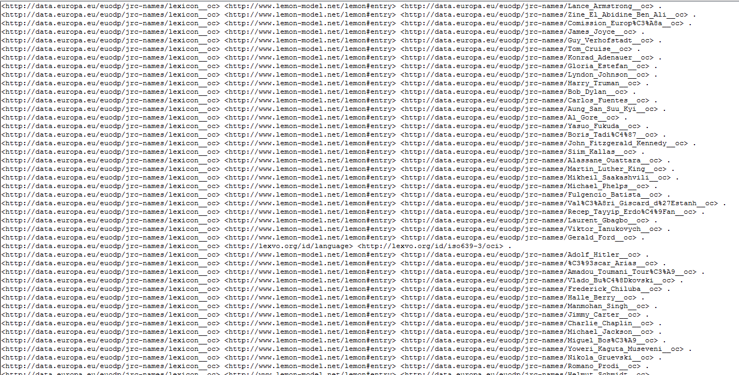

Slide 5
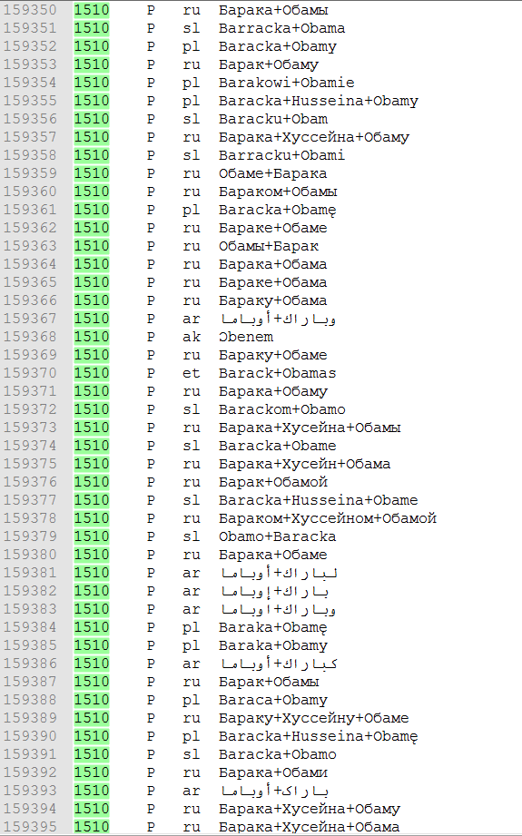
Unique Identifier
Name Variants
Type:
P – Person
O - Organisation
Language:
U – unknown
xx – ISO 639.2 code

Slide 6
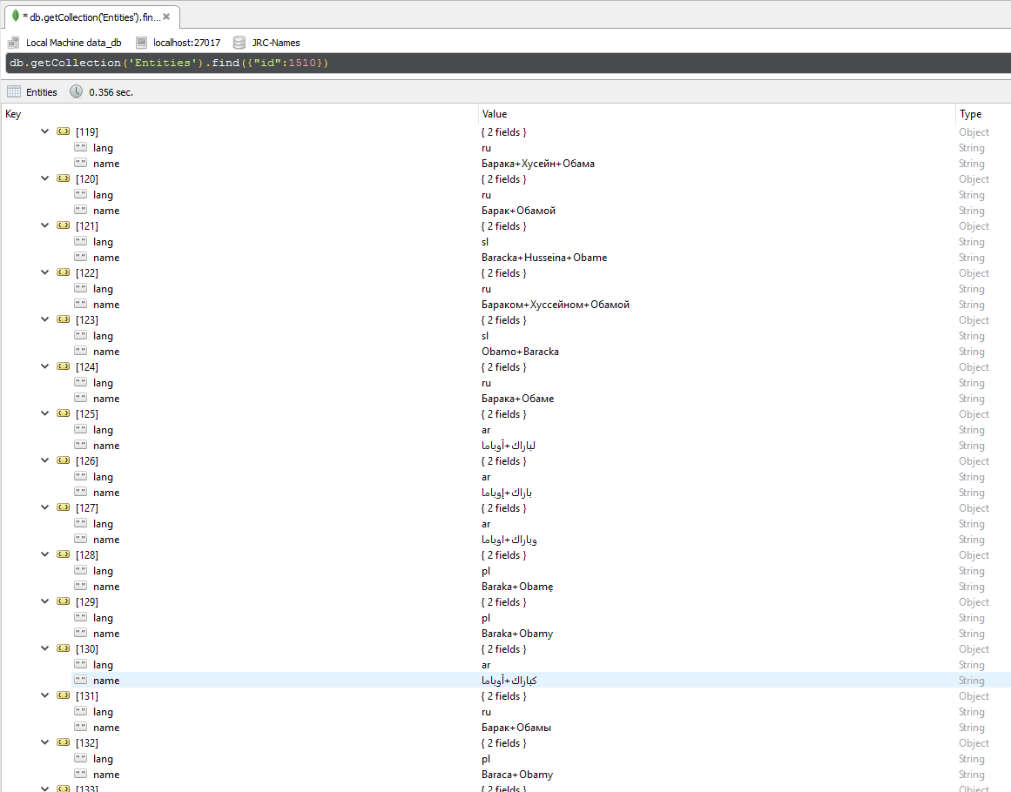

Slide 7
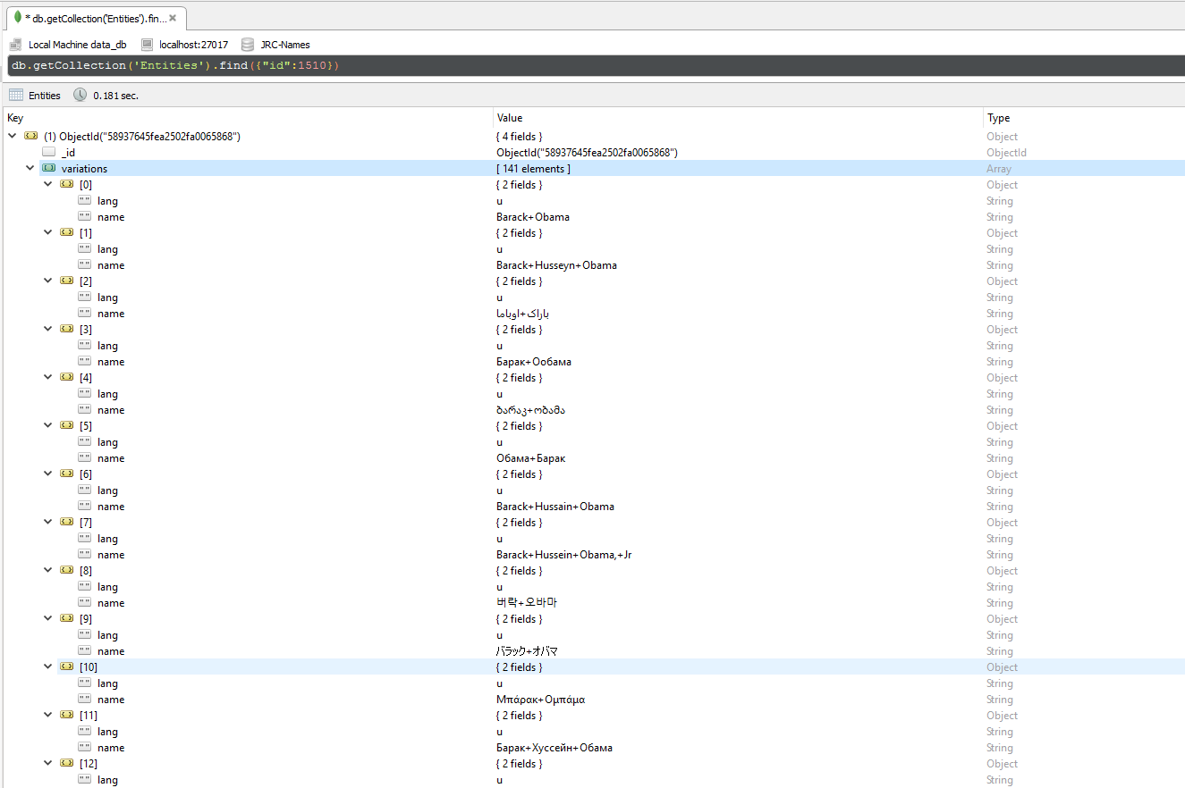

Slide 8
Reference
JRC Names https://ec.europa.eu/jrc/en/language-technologies/jrc-names
Ralf Steinberger, Bruno Pouliquen, Mijail Kabadjov, Jenya Belyaeva & Erik van der Goot, JRC-NAMES: A Freely Available, Highly Multilingual Named Entity Resource

